Slide 1

Attacking Terraform Environments
Attacking Modern Environments Series
Mazin Ahmed
DEFCON 29
mazin@mazinahmed.net | @mazen160
Attacking Terraform Environments Mazin Ahmed, 2021

Slide 2
$>whoami
Mazin Ahmed
AppSec and Offensive Security Engineer
Founder of FullHunt.io
Occasional Bug Bounty Hunter: Acknowledged by Facebook, Twitter, LinkedIn, Zoom, and more
In love ❤️ with Cloud security, security automation, DevSecOps, distributed systems, and Web-App security
Read more at mazinahmed.net

Slide 3
Agenda
Background: What is Terraform? How does it work?
Why do we need to learn to attack it?
Attack vectors and Scenarios
Demo 😈
Recommendations
Questions
Attacking Terraform Environments Mazin Ahmed, 2021

Slide 4
What is IAC (Infrastructure-as-code)?
IAC allows developers and organizations to define their infrastructure resources as code
Documented resources can be:
Reviewed through other systems - Git
Scanned for security and compliance on CI
Deployed and redeployed to other cloud providers
Self-service for deploying infra resources
Many more...
It’s amazing for Infra, Compliance, and Security teams and almost everyone in tech
Attacking Terraform Environments Mazin Ahmed, 2021

Slide 5

What is ?
Terraform is an open-source infrastructure as code software tool created by HashiCorp
Users define infrastructure configuration as code using HCL (HashiCorp Language)
Deployments and infrastructure state management happens through Terraform
It’s the most popular IAC orchestrator on the planet
Attacking Terraform Environments Mazin Ahmed, 2021

Slide 6
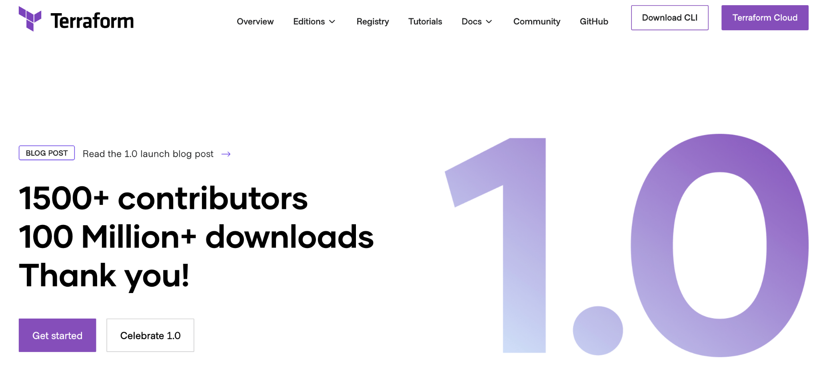
What is Terraform?
Attacking Terraform Environments Mazin Ahmed, 2021

Slide 7
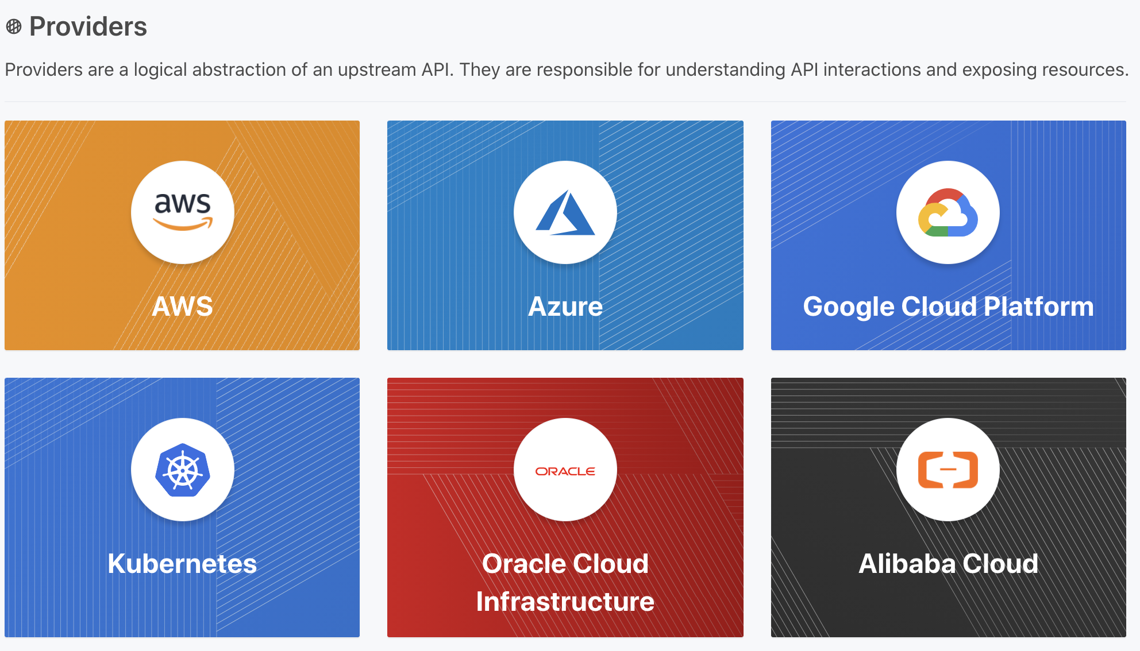
Attacking Terraform Environments Mazin Ahmed, 2021

Slide 8
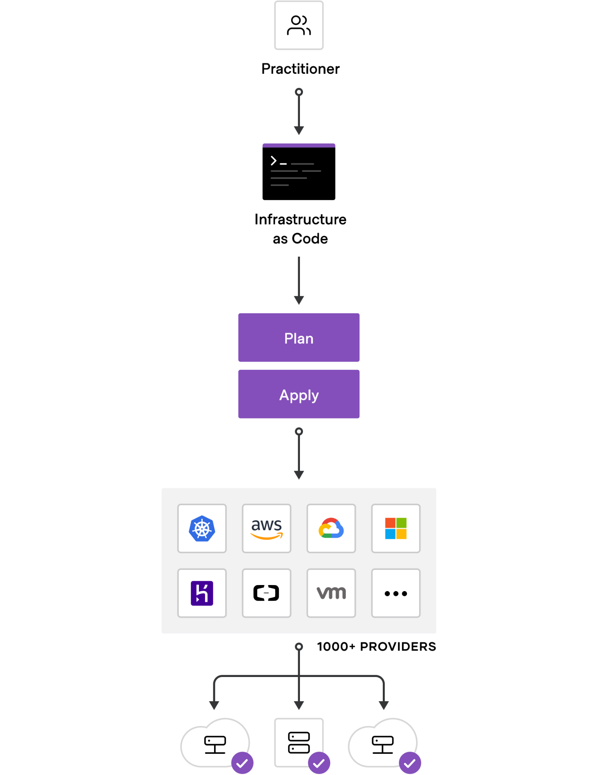
Attacking Terraform Environments Mazin Ahmed, 2021

Slide 9

Why do we learn to Attack ?
Attacking Terraform Environments Mazin Ahmed, 2021

Slide 10
“With great power comes great responsibility”
Attacking Terraform Environments Mazin Ahmed, 2021

Slide 11
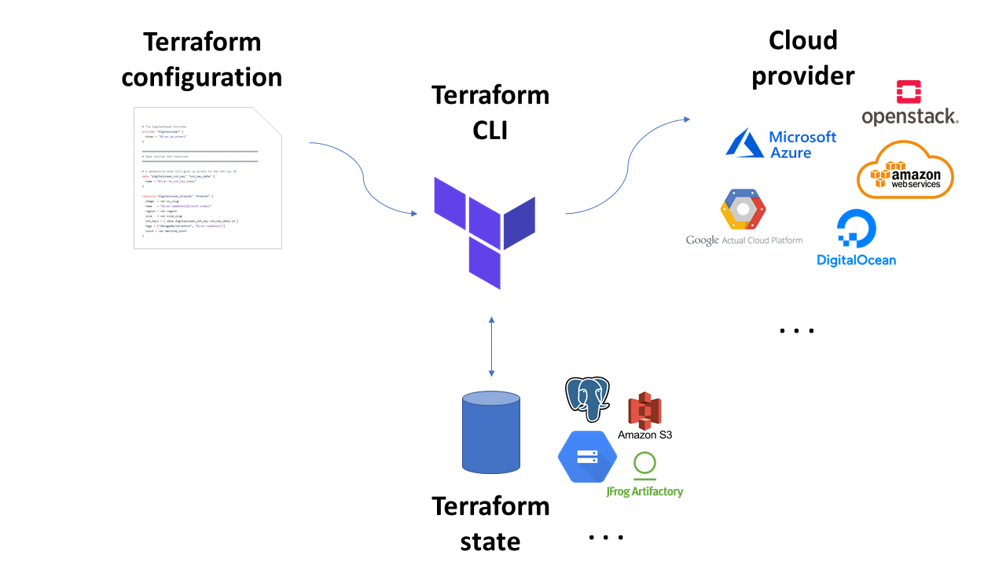
Attacking
The Terraform Controller has access to Everything
Attacking Terraform Environments Mazin Ahmed, 2021

Slide 12
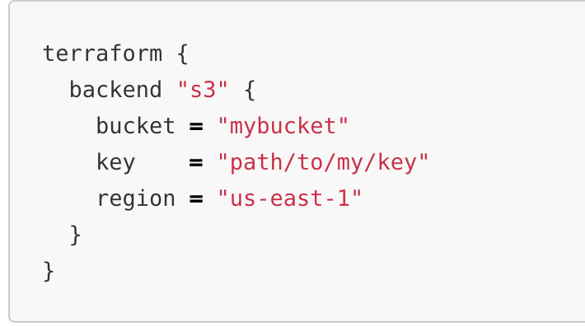
Attacking : S3 States
Attacking Terraform Environments Mazin Ahmed, 2021

Slide 13
Attacking : S3 States
If you have GetObject permission on the S3 bucket used for storing Terraform states files, then you will have access to secrets, AWS access keys, and DB credentials
Why?
Terraform needs these secrets for state and drift checks, and for deploying resources
Attacking Terraform Environments Mazin Ahmed, 2021

Slide 14
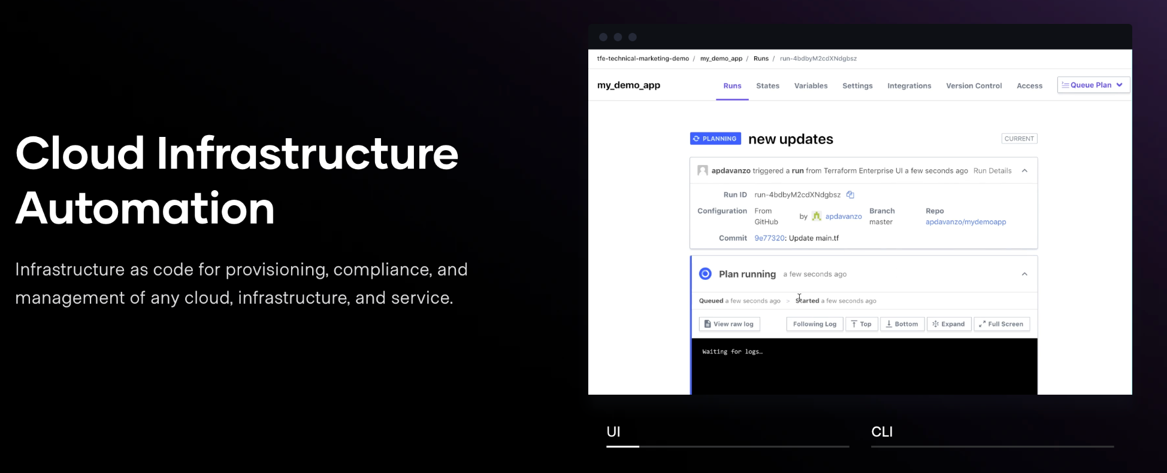
Attacking : States on TF Enterprise
Terraform Enterprise: the attack surface has just got larger
Attacking Terraform Environments Mazin Ahmed, 2021

Slide 15
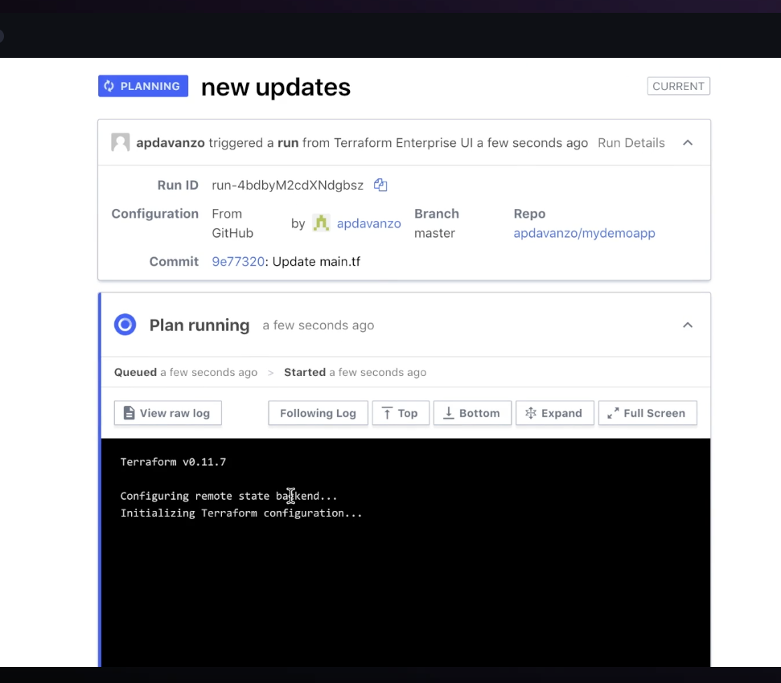
Attacking : States on TF Enterprise
Deployed as an instance
Self-hosted model
States can be stored in many ways:
PostgreSQL
AWS RDS
AWS S3
Mounted disks
Same Instance disk
More..
Attacking Terraform Environments Mazin Ahmed, 2021
Notes:
https://www.terraform.io/docs/enterprise/before-installing/index.html#operational-mode-decision

Slide 16
Attacking : States on TF Enterprise
If you compromise a TFE instance, you compromised the infrastructure
The Instance has access to
Access Keys
Configurations
Roles assigned to instances
DB Credentials
Everything...
Attacking Terraform Environments Mazin Ahmed, 2021

Slide 17
Attacking : States on TF Enterprise
Red-Team Tip
Compromised a TFE instance? This is the best place for attack persistence
Why?
Never gets touched after successful deployments
Upgrades or maintenance rarely happen
High permissions on Infrastructure
Always updated with latest DB credentials for the entire infrastructure
Attacking Terraform Environments Mazin Ahmed, 2021

Slide 18
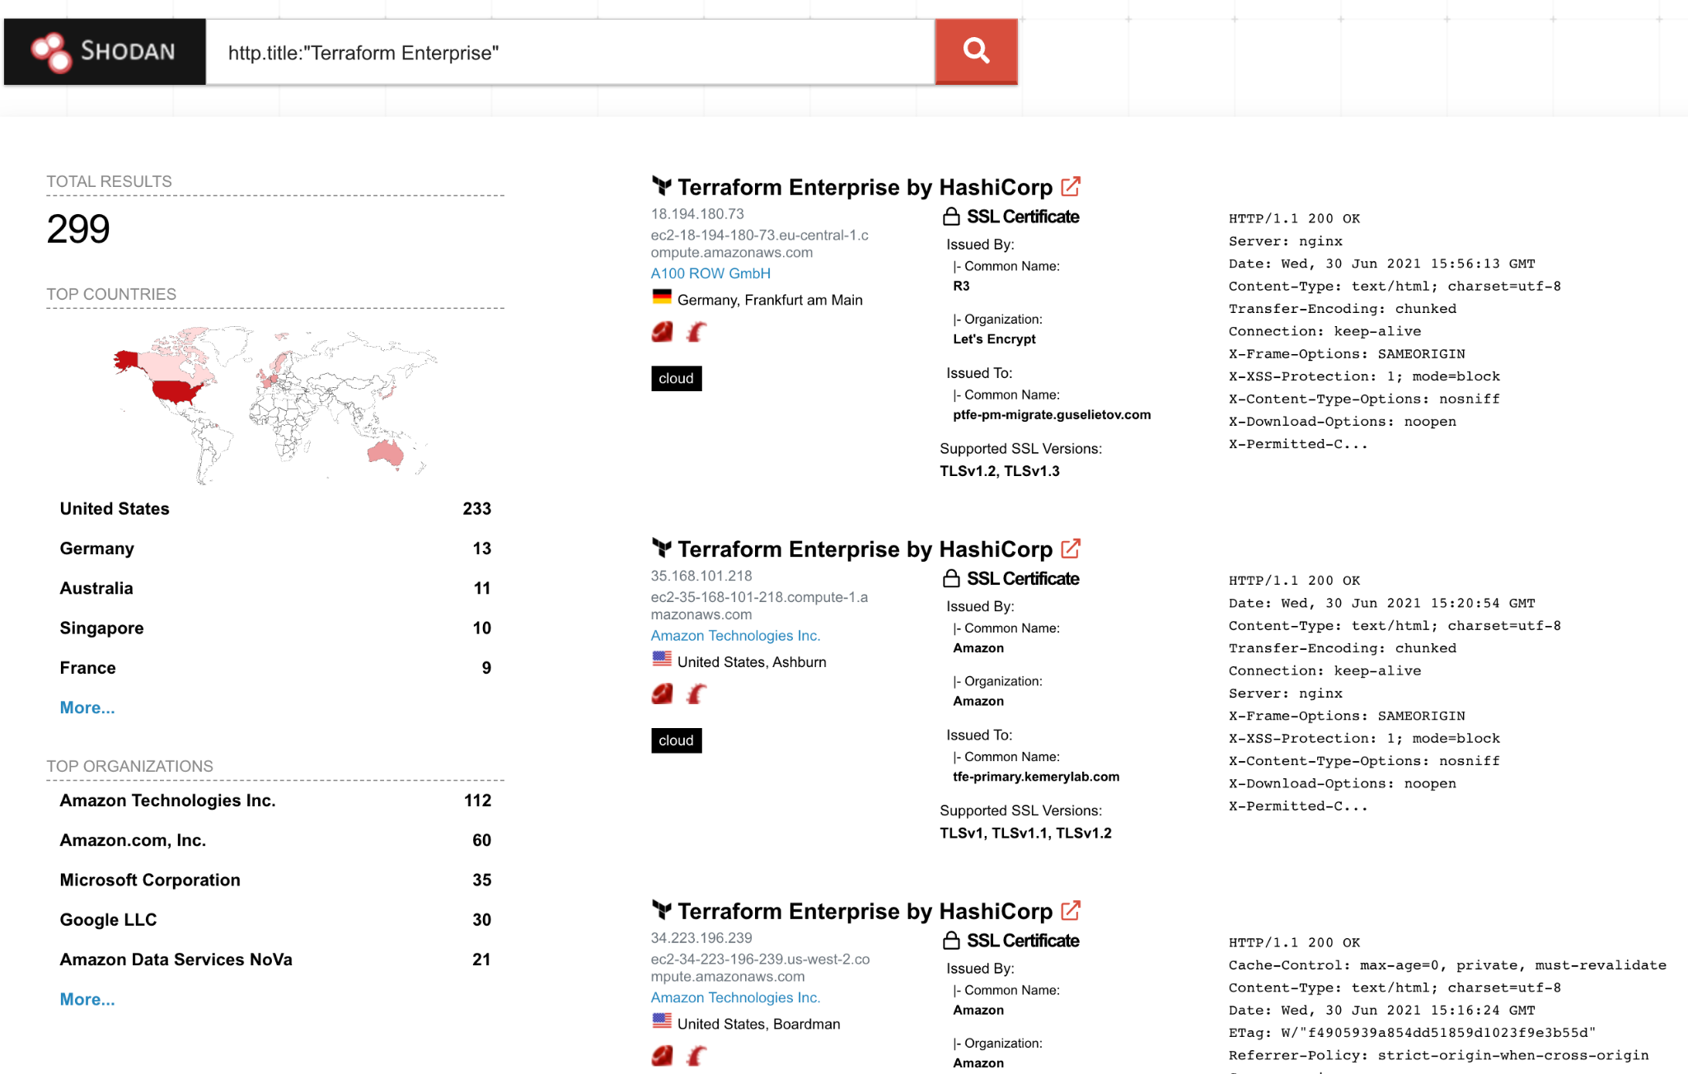
Attacking : TF Enterprise on the Internet 😱
Hundreds of organizations expose their Terraform Enterprise to the Internet 😱
Filters http.title:”Terraform Enterprise”
http.favicon.hash:1745085988
http.favicon.hash:1620173408
Attacking Terraform Environments Mazin Ahmed, 2021

Slide 19
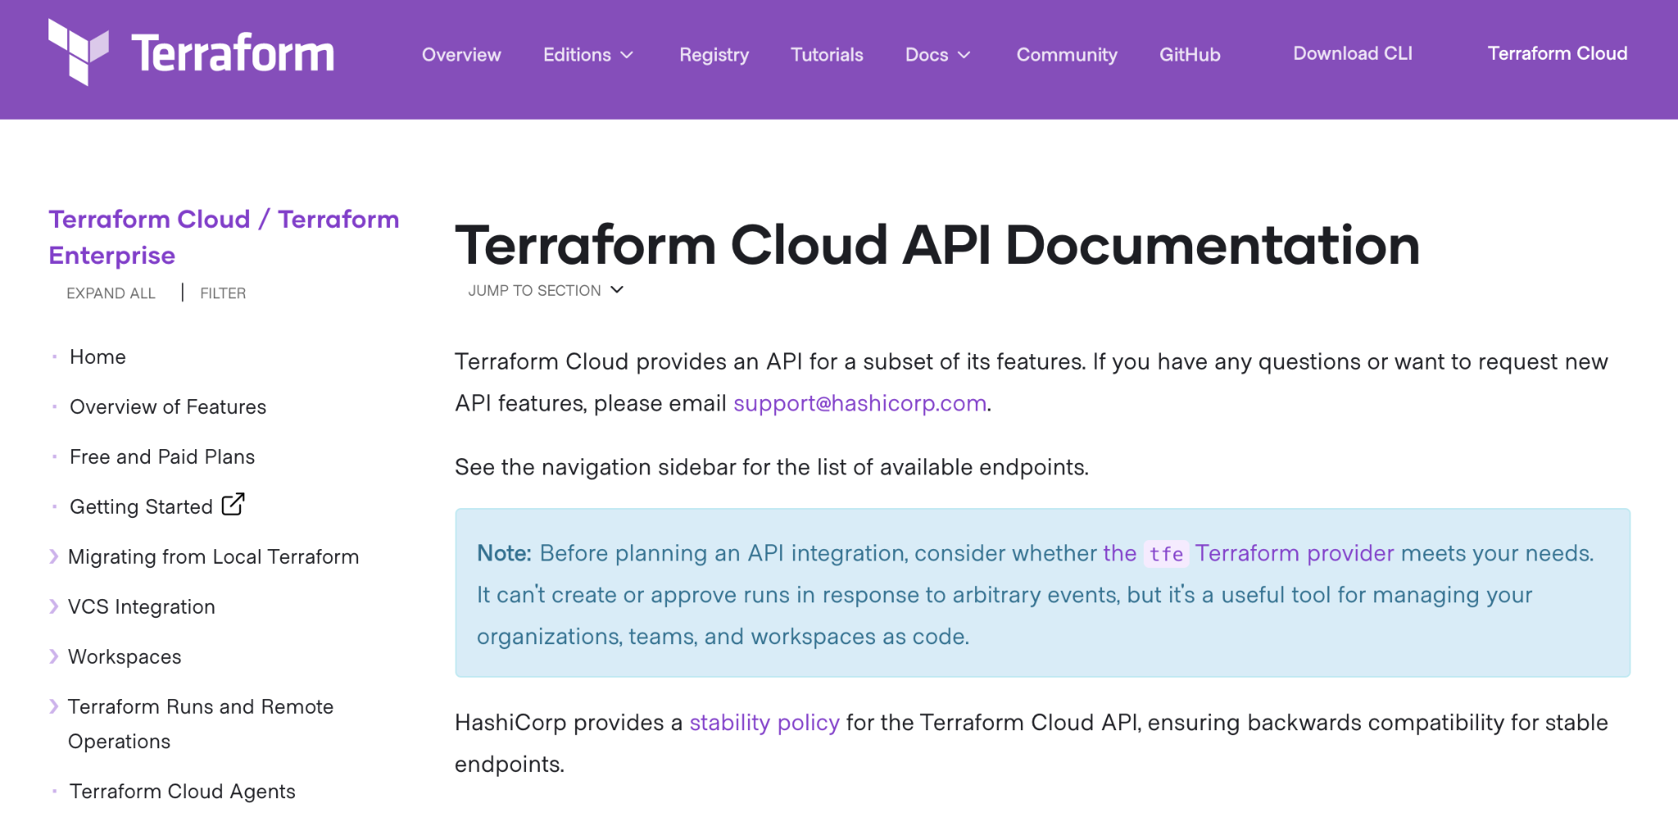
Attacking : (Ab)using Terraform APIs
Attacking Terraform Environments Mazin Ahmed, 2021

Slide 20
Attacking : (Ab)using Terraform APIs
Terraform Cloud and Terraform Enterprise have dedicated APIs that can be used for automating functionalities and tasks.
This can be used in running plans, retrieving metadata, and fully manage the Terraform deployment
Attacking Terraform Environments Mazin Ahmed, 2021

Slide 21
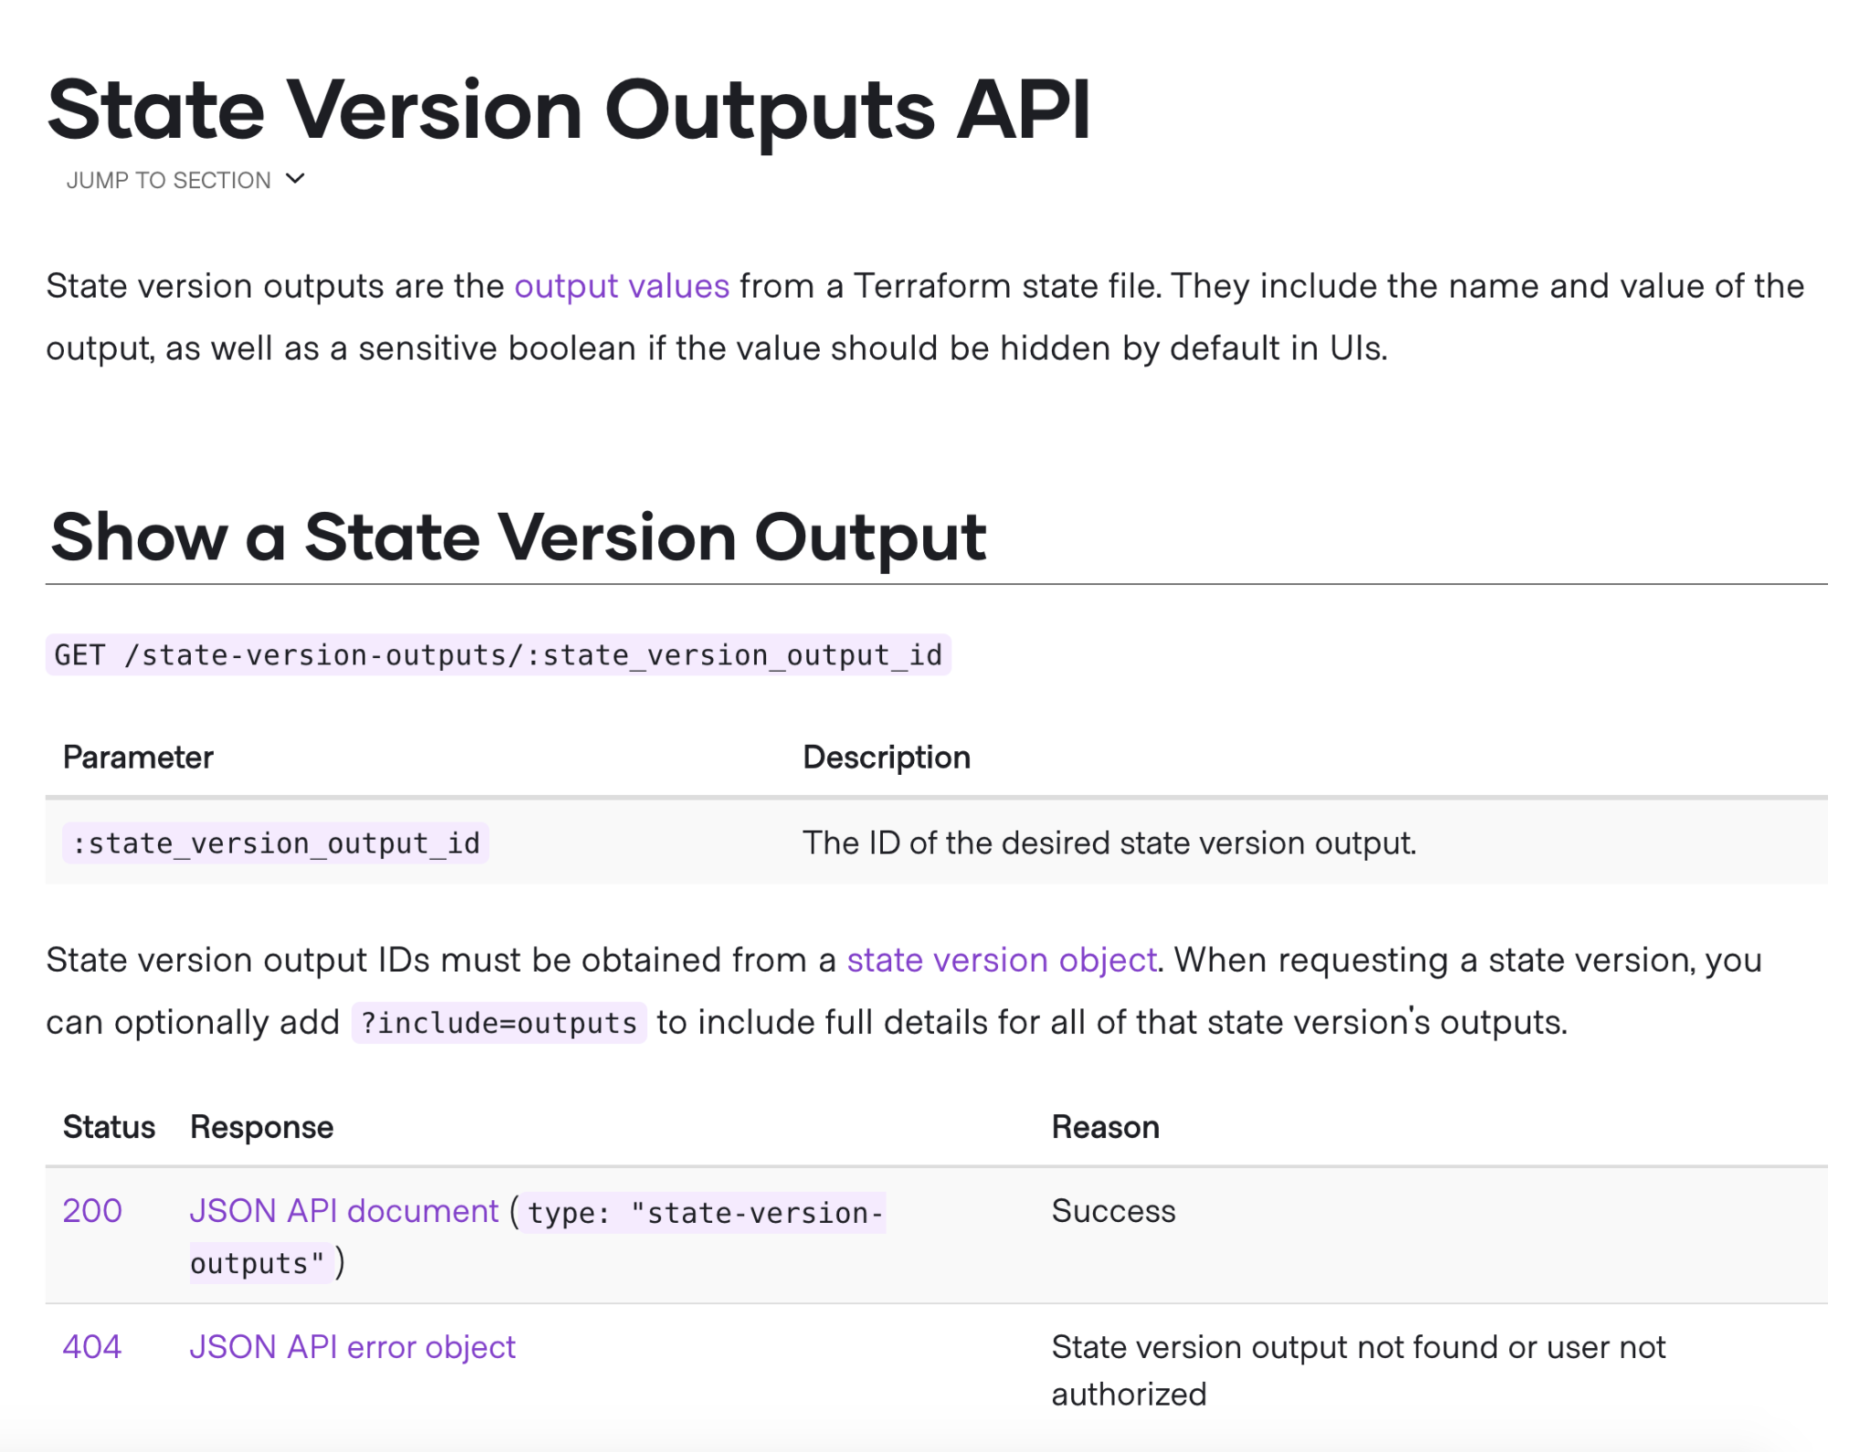
Attacking : (Ab)using Terraform APIs
Terraform Cloud and Enterprise offers an API that allows retrieving state files.
If it wasn’t possible to compromise the DB responsible for storing states files, it’s possible to ask Terraform Cloud/Enterprise to print it in plain text 🙃.
This will mostly contain sensitive information about the Infrastructure, and clear-text credentials.
Attacking Terraform Environments Mazin Ahmed, 2021

Slide 22
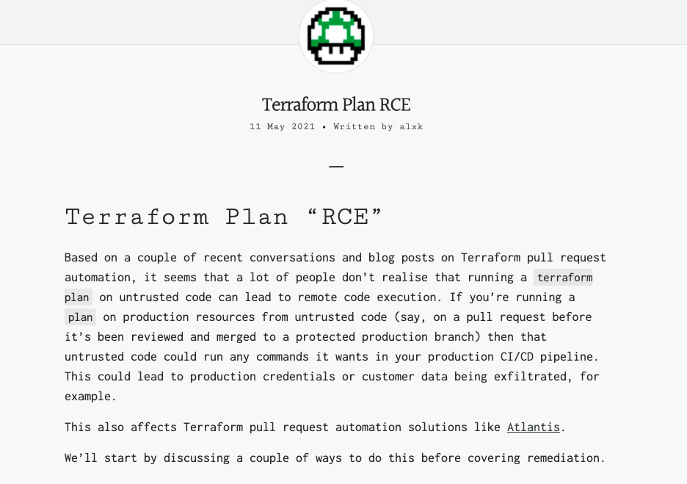
Attacking : Remote Code Execution on Terraform Enterprise
Attacking Terraform Environments Mazin Ahmed, 2021

Slide 23
Attacking : Remote Code Execution on Terraform Enterprise
Terraform Plan allows RCE when being executed
A person that submits a PR can execute a payload, and compromise the Terraform Enterprise instance
This can result in the compromise of the entire infrastructure when submitting a single PR.
Credits: @_alxk
Attacking Terraform Environments Mazin Ahmed, 2021

Slide 24
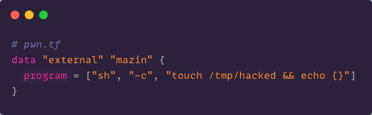
Attacking : Remote Code Execution on Terraform Enterprise
Submit a PR with the following code:
Attacking Terraform Environments Mazin Ahmed, 2021

Slide 25
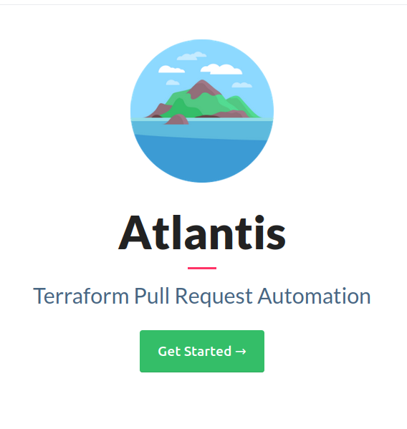
Attacking : More Vulnerable Platforms?
Atlantis is also vulnerable to the same attack
Erik Osterman tried to introduce a fix in 2018, and it was rejected
The fix was to restrict “terraform plan” runs to authorized members only. A start to fix the issue, but doesn’t fully resolve the problem.
Attacking Terraform Environments Mazin Ahmed, 2021

Slide 26
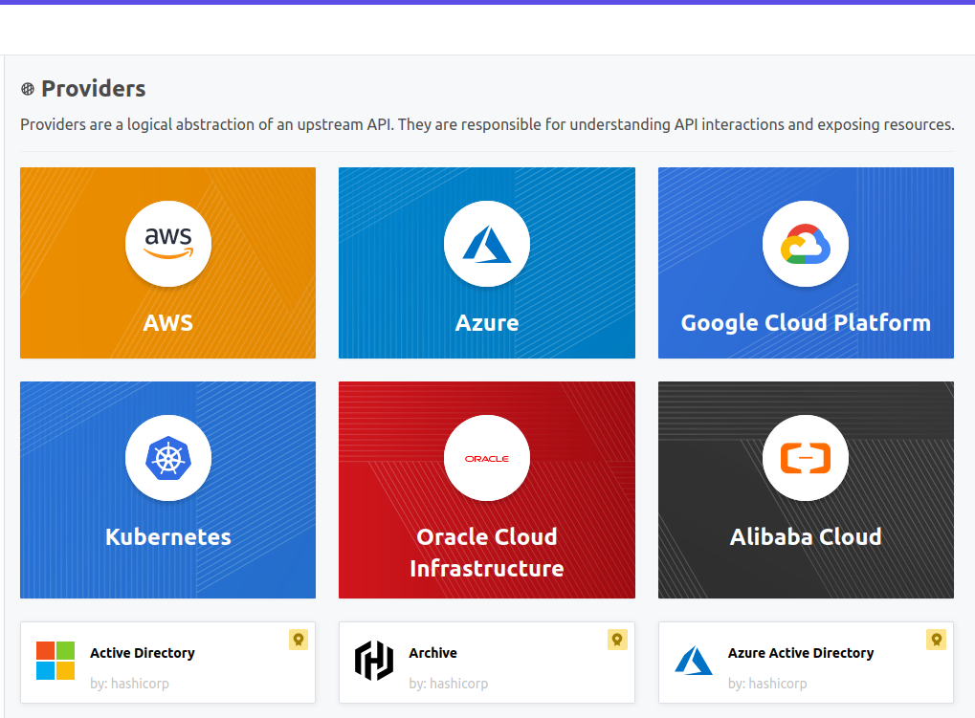
Attacking : Evil Provider Attack
Publishing providers is automated.
This is made to encourage providers to publish apps to Terraform.
Attacking Terraform Environments Mazin Ahmed, 2021

Slide 27
Attacking : Evil Provider Attack
“Trust, but verify”
Attacking Terraform Environments Mazin Ahmed, 2021

Slide 28
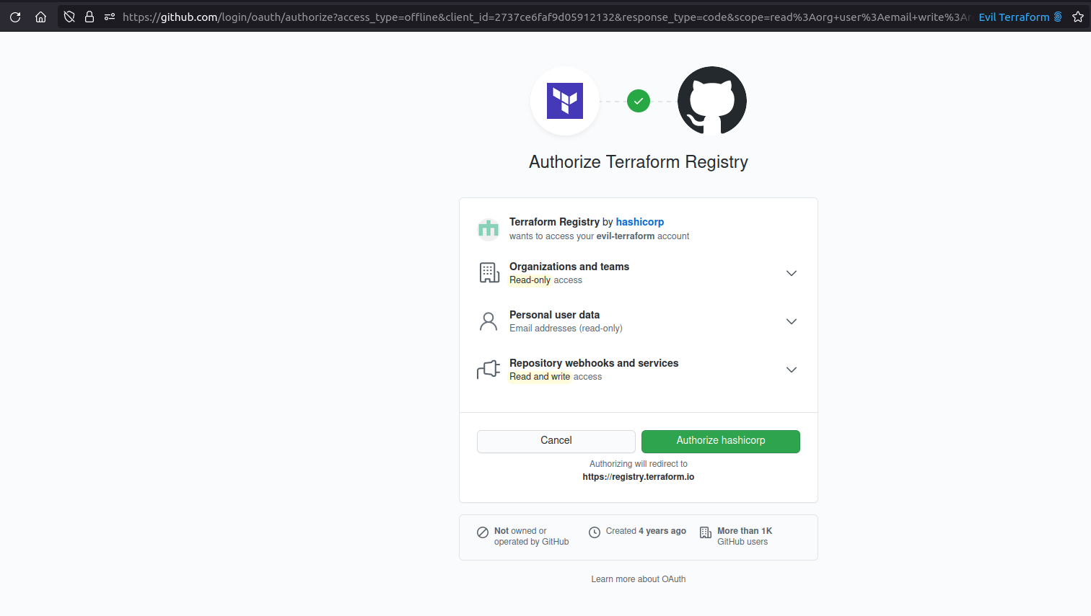
Attacking : Evil Provider Attack
Let’s try to exploit this in real-life
Setting up a provider :)
Attacking Terraform Environments Mazin Ahmed, 2021

Slide 29
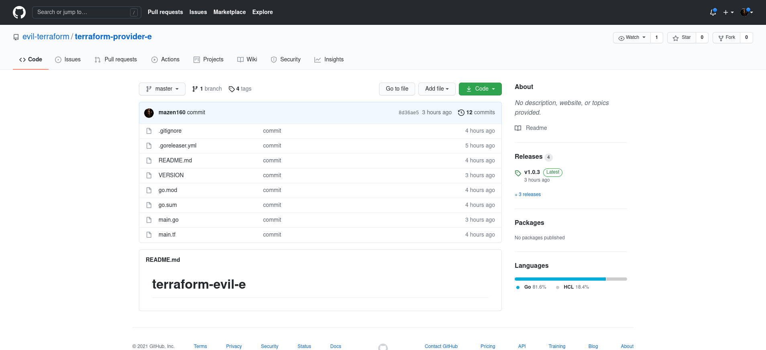
Attacking : Evil Provider Attack
Attacking Terraform Environments Mazin Ahmed, 2021

Slide 30
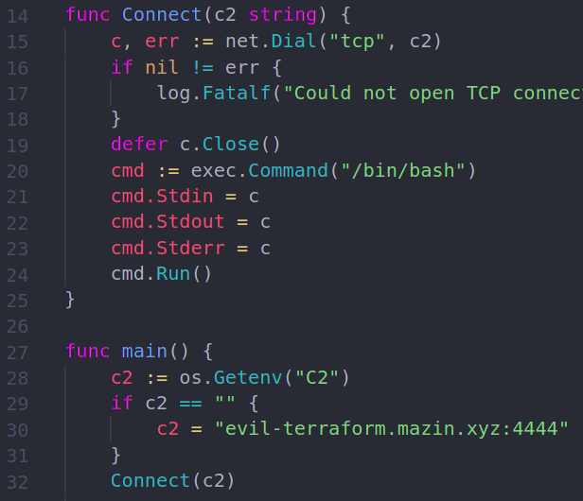
Attacking : Evil Provider Attack
I developed a simple Terraform provider that is backdoored
Grants a reverse TCP shell on execution to my C2 server
Attacking Terraform Environments Mazin Ahmed, 2021

Slide 31
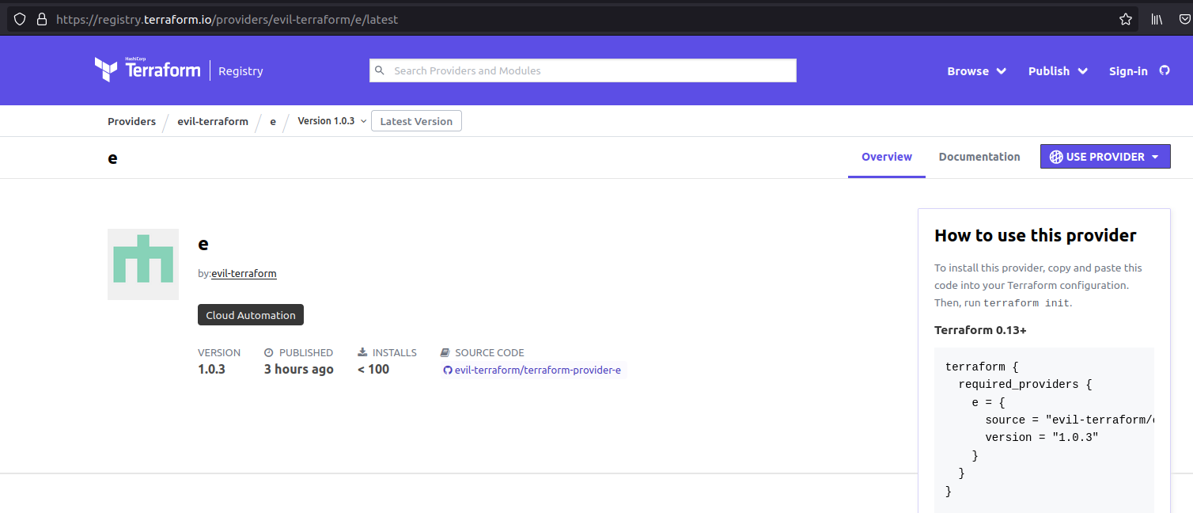
Attacking : Evil Provider Attack
Attacking Terraform Environments Mazin Ahmed, 2021

Slide 32
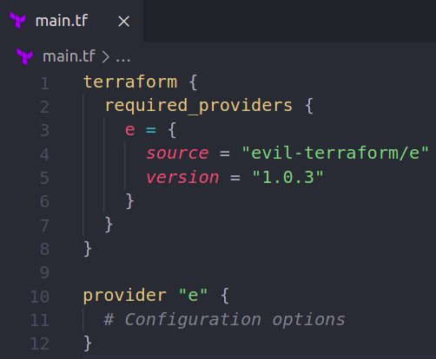
Attacking : Evil Provider Attack
I pushed code to Terraform repository
Attacking Terraform Environments Mazin Ahmed, 2021

Slide 33
Attacking : Evil Provider Attack
{{demo}}
Popping Shell in Terraform Cloud (Hosted by HashiCorp)
Attacking Terraform Environments Mazin Ahmed, 2021

Slide 34
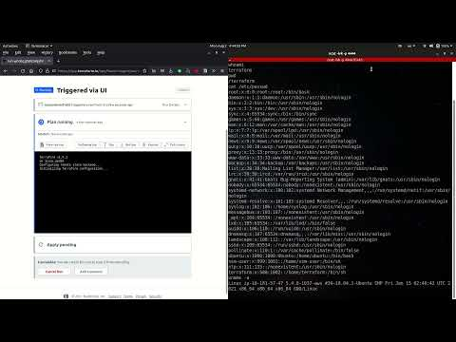
Attacking : Evil Provider Attack
Attacking Terraform Environments Mazin Ahmed, 2021

Slide 35
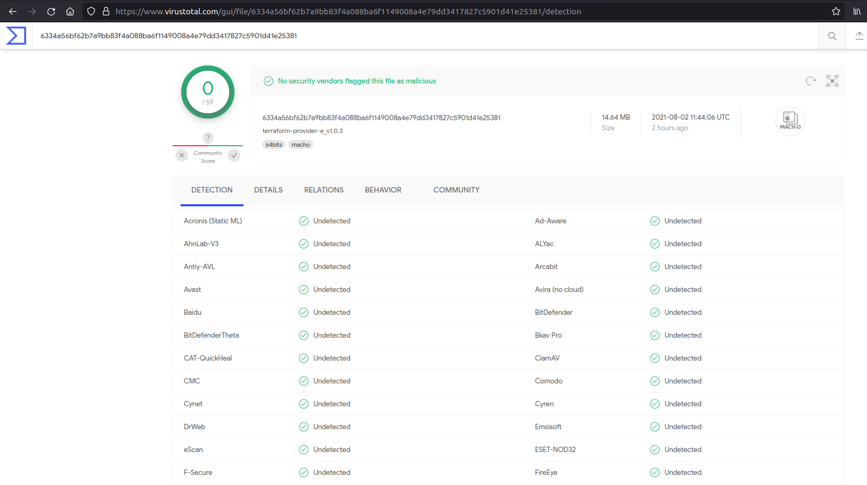
Attacking : Detection?
Attacking Terraform Environments Mazin Ahmed, 2021

Slide 36
Attacking : Terms of Use?
Warning:
This attack is against Terms of Use by HashiCorp. Running this in an account may result in account suspension.
Attacking Terraform Environments Mazin Ahmed, 2021

Slide 37
: Security Team Response
Within hours of my exploitation, HashiCorp security detected the Evil Provider Attack, and contacted me directly to chat about my findings
We discussed about various ideas and thoughts to introduce a fix at Terraform
I appreciate HashiCorp’s efforts in handling and analyzing the research 🙏
Attacking Terraform Environments Mazin Ahmed, 2021

Slide 38
Recommendations
Be careful: It’s difficult to maintain a secure Terraform environment. Being careful is my main recommendation.
Attacking Terraform Environments Mazin Ahmed, 2021

Slide 39
Recommendations
When using S3 as the remote backend, implement a proper bucket access policy to prevent other users from accessing the bucket other than the Terraform user.
Attacking Terraform Environments Mazin Ahmed, 2021

Slide 40
Recommendations
Continuously update and review your TFE instance. It can be easily forgotten in the noise.
Attacking Terraform Environments Mazin Ahmed, 2021

Slide 41
Recommendations
Be careful in permitting people to have write access on any branch of Terraform repository, it can lead to direct code execution, and there is no way to patch it.
Attacking Terraform Environments Mazin Ahmed, 2021

Slide 42
Recommendations
Maintain TFE in an isolated VPC - do not expose it to the Internet
Attacking Terraform Environments Mazin Ahmed, 2021

Slide 43
Recommendations
State files are sensitive. They contain data that ranges from DB passwords, to access keys and SSL/TLS certificates. Treat them as sensitive data.
Attacking Terraform Environments Mazin Ahmed, 2021

Slide 44
Recommendations
A good idea to set up a CI check for rogue Terraform providers to aid in exploitation discovery.
Attacking Terraform Environments Mazin Ahmed, 2021

Slide 45
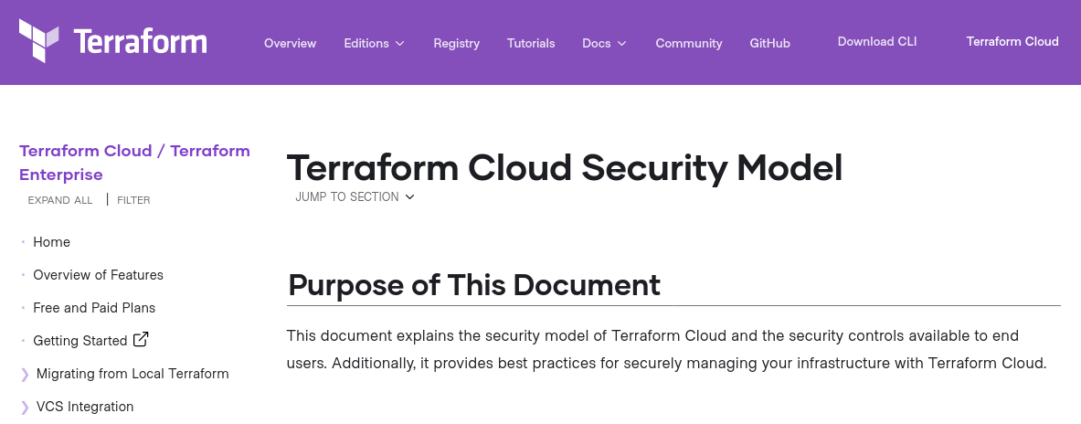
Recommendations
Good read: Terraform Cloud Security Model
Attacking Terraform Environments Mazin Ahmed, 2021

Slide 46

Final Thoughts
Terraform is amazing
It brings several security features when implementing IAC with Terraform
With great power comes great responsibility - protect your Terraform environment
Stay safe! Set up persistent monitor like to discover Shadow IT, misconfigurations, and mistakenly exposed services :)
Attacking Terraform Environments Mazin Ahmed, 2021

Slide 47
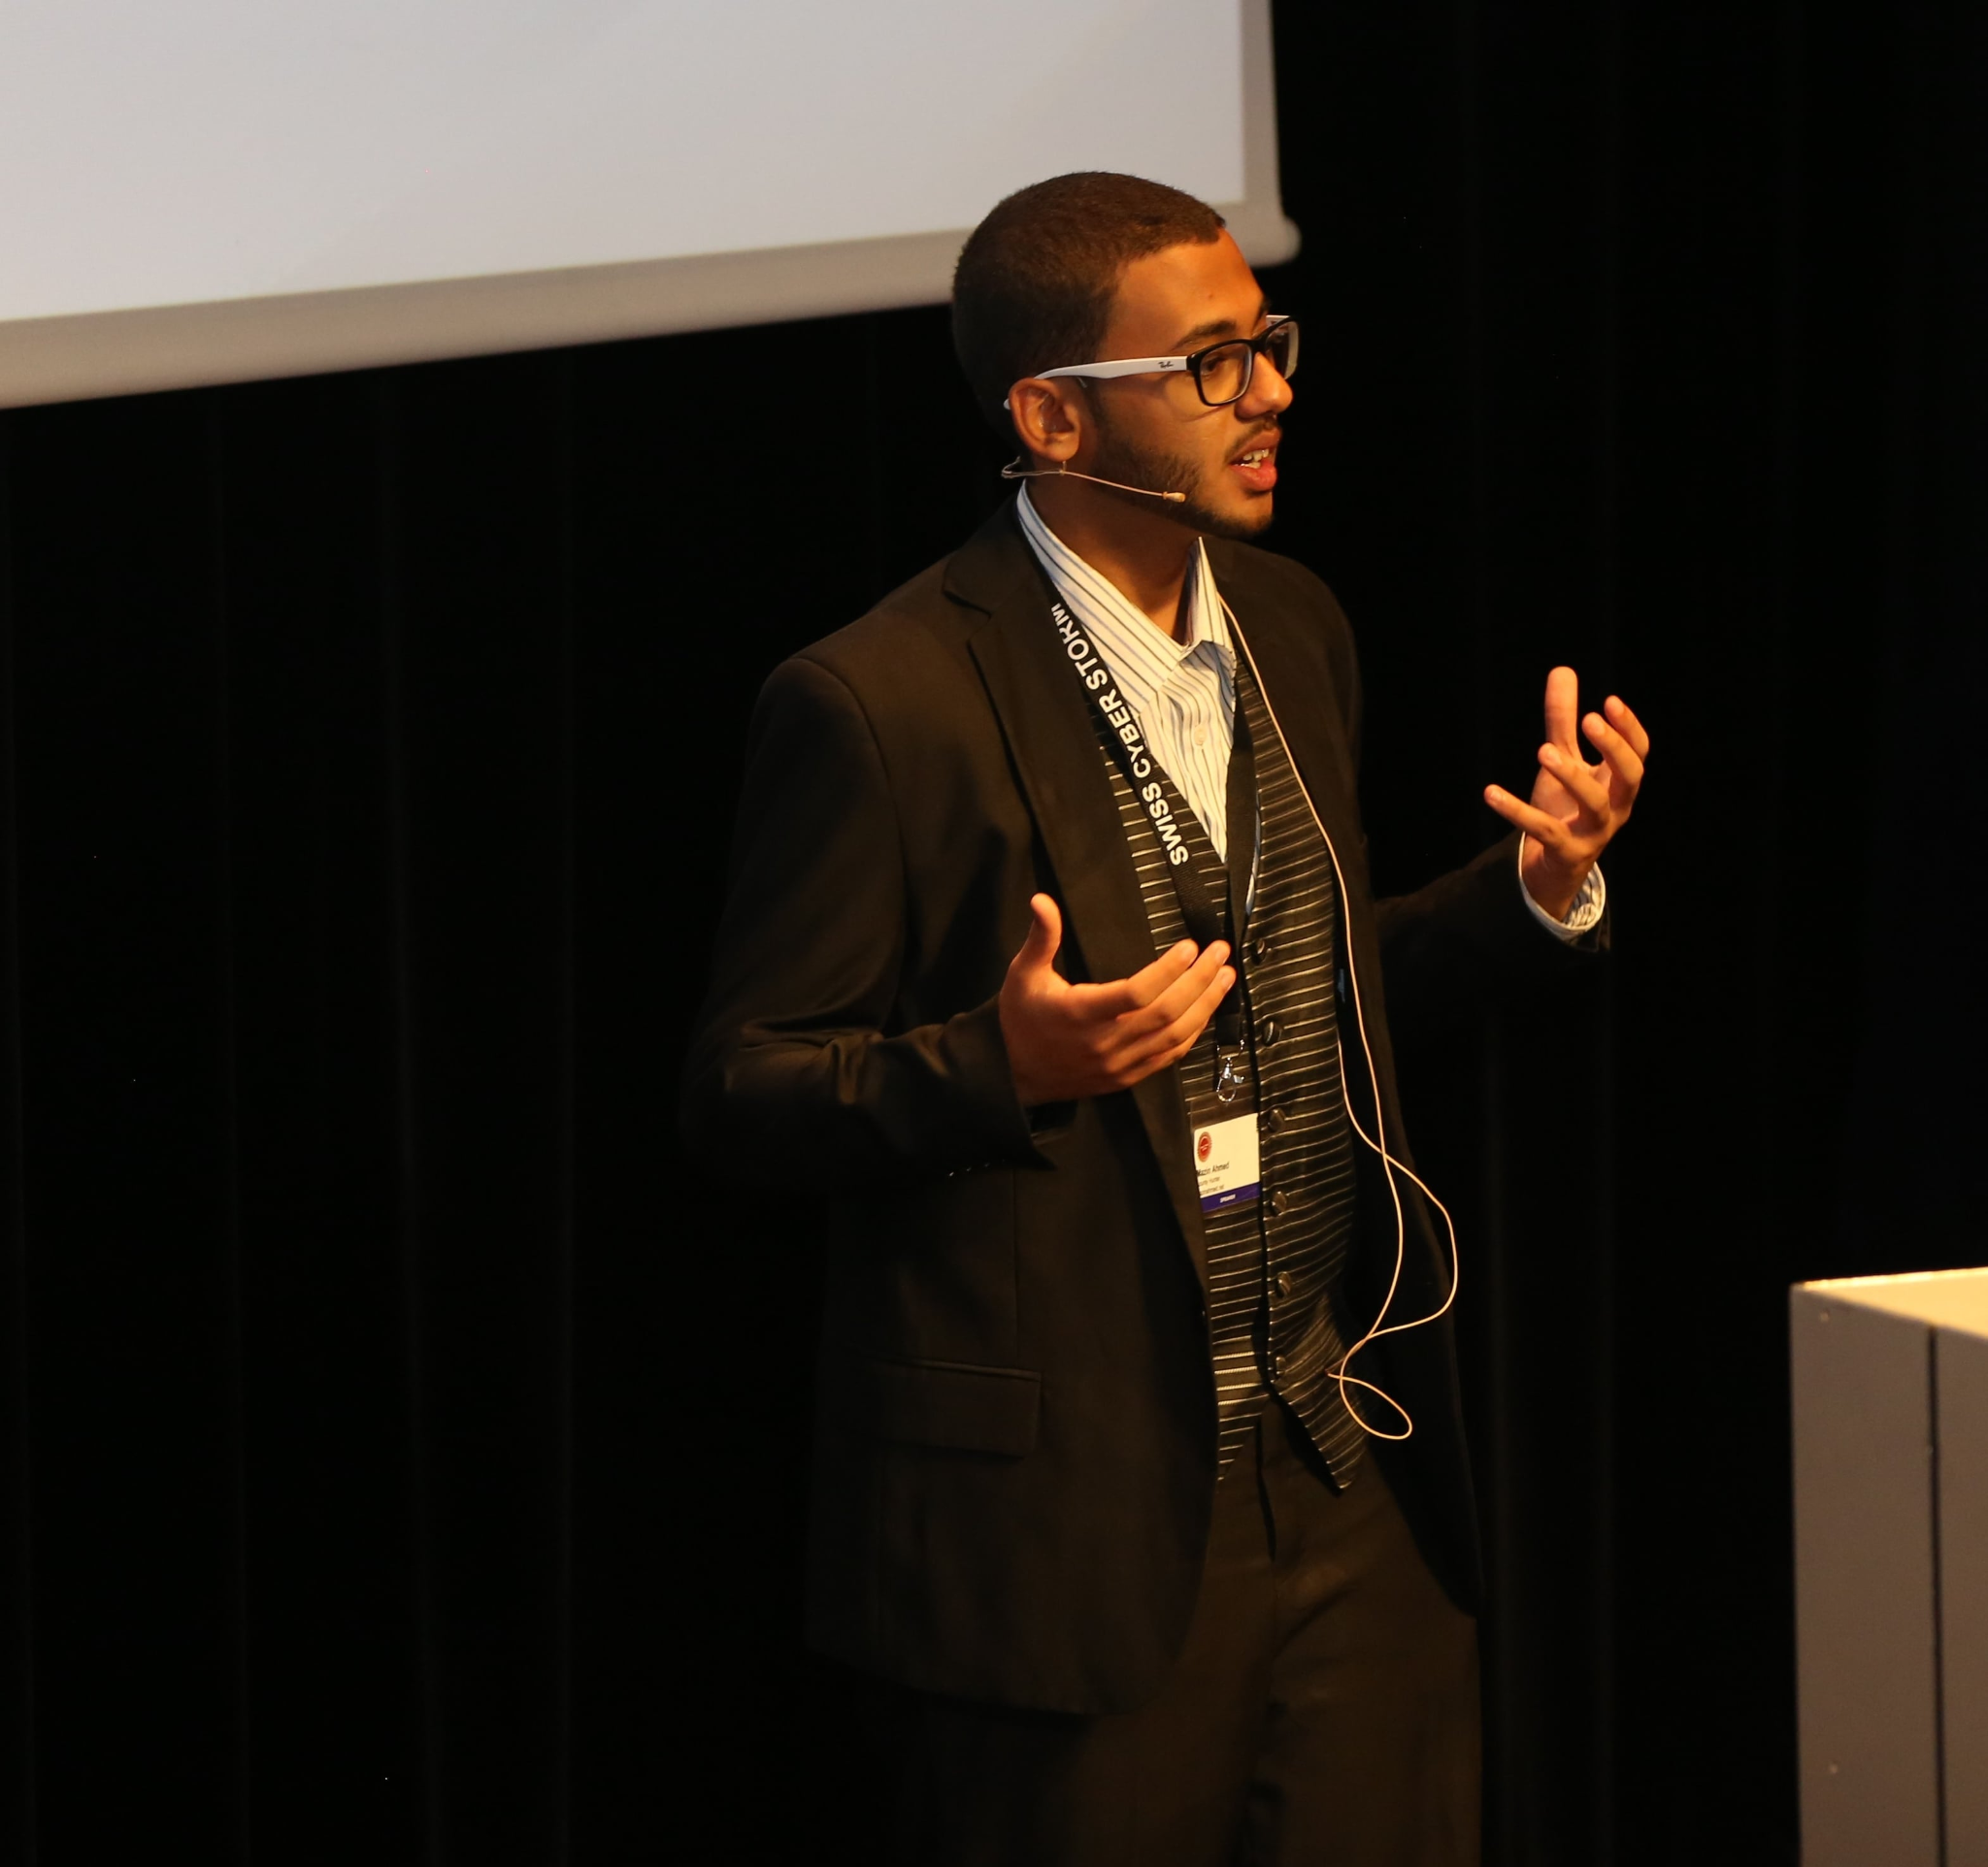
Questions?
Looking for the next world-class Cloud Security?
Mazin Ahmed
mazin@mazinahmed.net
Twitter: @mazen160
Attacking Terraform Environments Mazin Ahmed, 2021

